Slide 1
Bessere Zusammenarbeit mit OneDrive for Business Moderne Dateianhänge mit Exchange 2016 und Office 365
Exchange User Group Berlin | 22. Februar 2018

Slide 2
Thomas Stensitzki
Enterprise Consultant Granikos GmbH & Co. KG
MCT MCSM Messaging, MCM: Exchange 2010 MCT, MCSE, MCITP, MCTS, MCSA, MCSA:M, MCP
thomas.stensitzki@granikos.eu http://JustCantGetEnough.granikos.eu

Slide 3
OneDrive for Business
Ein Überblick

Slide 5
Microsoft 365: Universal toolkit for teamwork
Outlook
Office Apps
SharePoint
Yammer
Teams
Email and calendar
Co-author
Intranets and content management
Connect across
the organization
Hub for teamwork
Office 365 Groups
Single team membership across apps and services
Microsoft Graph
Suite-wide intelligence connecting people and content
Security and Compliance
Centralized policy management

Slide 6
SharePoint and OneDrive connect the workplace with intelligent content management and intranets
Share and work together
Inform and engage people
Transform business processes
Harness collective knowledge
Protect & manage | Extend & develop

Slide 7
SharePoint and OneDrive cloud momentum
300k
85%
65%
organizations
of Fortune 500
of all seats are online
90%
300%
7x
growth in active users
growth in sync usage
Gartner & Forrester Leader

Slide 8


OneDrive with Office 365
Share and work together on all your files
Access files from all your devices
Share inside or outside
your organization
Collaborate with
deep Office integration
Quickly find files
that matter most
Protect your work with enterprise grade
security and compliance

Slide 9
PDF previewer + PDF conversion
View Office docs in app
ODB push notifications
Discover view V2​
Me tab (mobile)
My analytics (mobile)
iMessage support
New sharing dialog in ODB/SPO
“Get a link”—Share from Explorer/Finder
New sharing experience (Explorer and Finder, Win32 W/E/P, Web W/E/P, Web, Mobile—ODB and SPO)
OCS (Office collab service) support
ODB file handlers preview
Sites in ODB
250+ new web viewers (including 3D, etc.)
Office instant previewers (Word, PPT)
Office unified apps (Word, PPT)
ODB new shared with me, shared by me
ODB access stats on file, activity feed
ODB flow integration
At-a-glance sharing information on any folder
ODB/SPO revamped sharing mails
Shareable links for ODB folders
Shareable links (web, mobile, sync)
Sharing warnings for large scale disclosure
Beautiful OneDrive link previews in OWA (ODC and ODB)
Outlook (web, Win32, iOS, Android) cloud attachments default to user-friendly permissions (works like regular attachments)
ODB sharing notifications on mobile
Share (ODC, ODB) and edit (ODC) notifications in WEP
Owners can require approval for reshares
Notifications on re-sharing
See who has opened sharing links (web)
Sharing mails come from users mailbox
Recipients of sharing emails know whether links are re-shareable
Respond to access requests directly from Outlook
@mention and email notifications for Win32 Word
Developer, photos
OneDrive API for On Prem
Albums and bundles for photos
API optimizations for mobile
Links open right
SharePoint sites in graph
SharePoint lists in graph
OneDrive Dev Portal migrates to MS Graph Portal
S2S auth support for API
File versions API
Animated GIF support (mobile)
Clean up space on Android
Office lens integration
ODB video streaming (mobile, web)
Camera roll upload on HoloLens
Team sites sync
Mobile team sites support
Marquee select + design updates (mobile)
3D touch support
Mobile Single Sign On (W/X/P/ON, Outlook, Skype for Business, SharePoint, ...)
Mobile On Prem support
Xbox One App
Conditional access for Sync (preview)
Location-based CA (mobile)
PowerLift integration
Support for Visio handoffs (mobile)
Document picker support (iOS)
Voice commands on HoloLens
Files On-Demand preview​
Pause sync
OCSI (MSI, consumer C2R, and team sites)
Office centennial sync integration
Mac standalone SKU
IRM sync (preview)
“Report a problem”
File overlay repair
Real-time telemetry pipeline (Sync)
Windows Telemetry updates/compliance
Multi-geo support
Go Sov support
1ES engineering pipeline
Accessibility Grade B (All)
#, % name support
MAX_PATH support
Windows information protection (UWP, Sync)
New ODB admin portal
New Windows RS2,3 OOBE
Modern details pane (web)
ODC Realtime web updates; ODB MVP
Download multiple files
1-UppPreviewer UX polish and performance
ODB search result filtering
ODB new list, grid, and recent UX
EU cookie regulation support
Files On-Demand tutorial
ODB/SPO file zip viewer
Admins can
Prevent external users from re-sharing
ODB and SPO respect Exchange AB policy
Block external users from seeing each other
Limit external sharing to specific users
Block sharing of sensitive documents externally
Limit anonymous links to specific users
Require external users to re-verify email every 30 days
All photos performance
ODB image object detection
New File Picker (including SharePoint Site)
Over 100 new features and functionality added this year

Slide 10

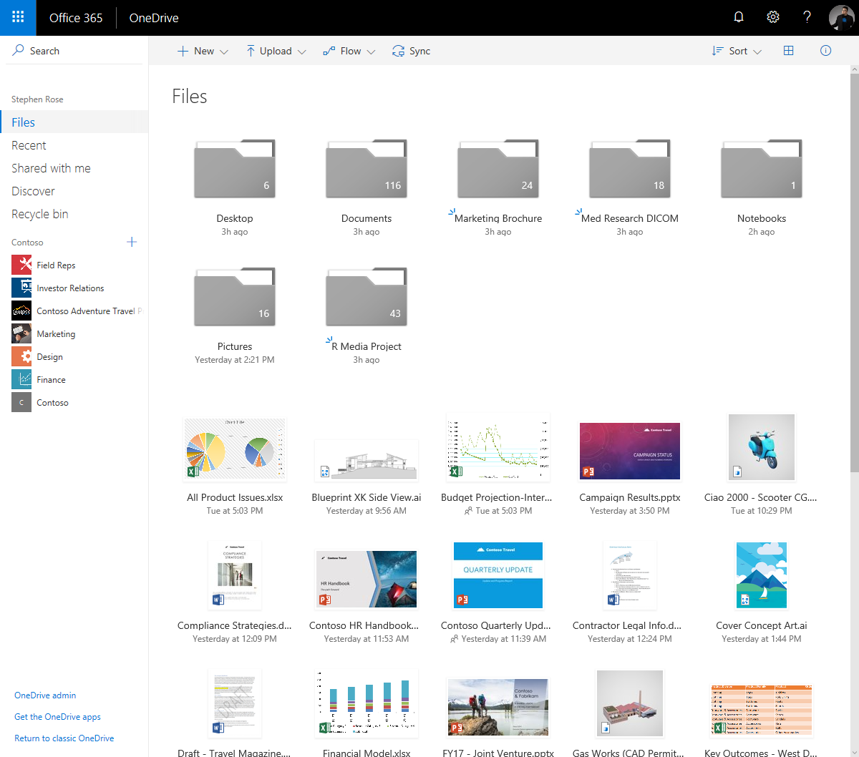
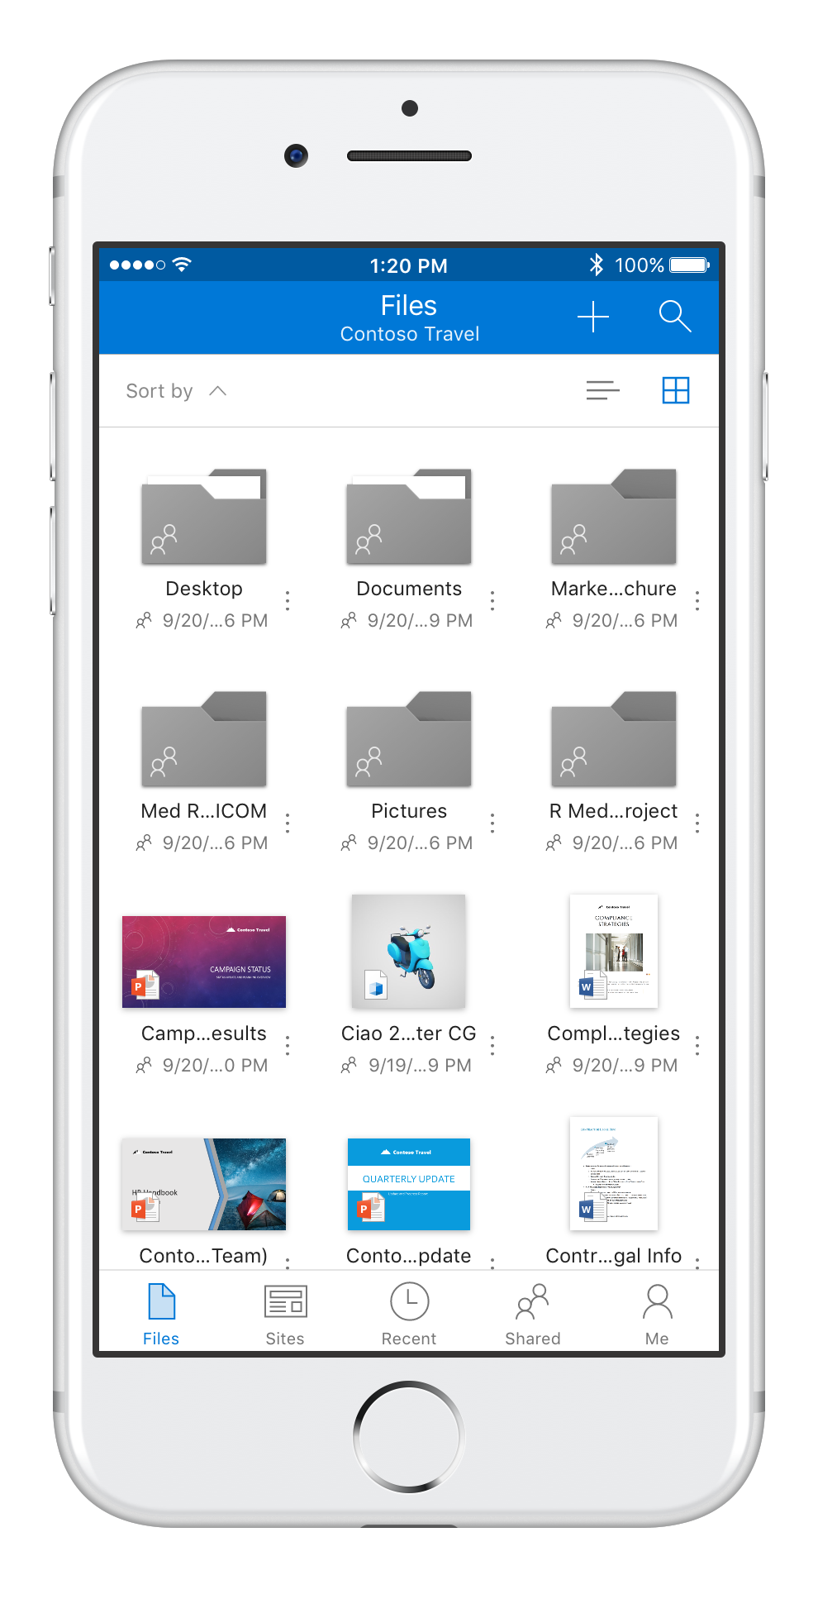
Access files from all your devices
Full fidelity web experience with preview support for 270+ file types and growing
Work from the desktop and offline with robust sync options for PCs and Macs, incl. Files On-Demand in Windows 10
Work from anywhere with 4+ rated mobile apps on iOS and Android
Access personal and shared file from OneDrive and SharePoint

Slide 11
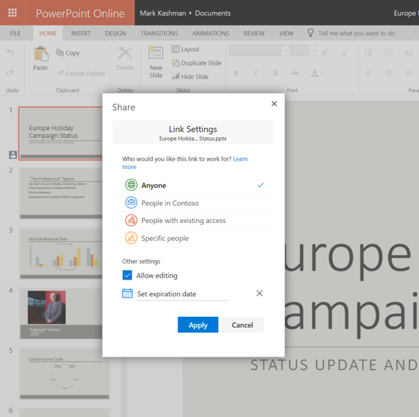
Collaborate with deep Office integration
Share seamlessly and consistently
Open documents faster than ever in Office web apps
Co-author documents in the Office web apps, desktop clients and mobile apps

Slide 12
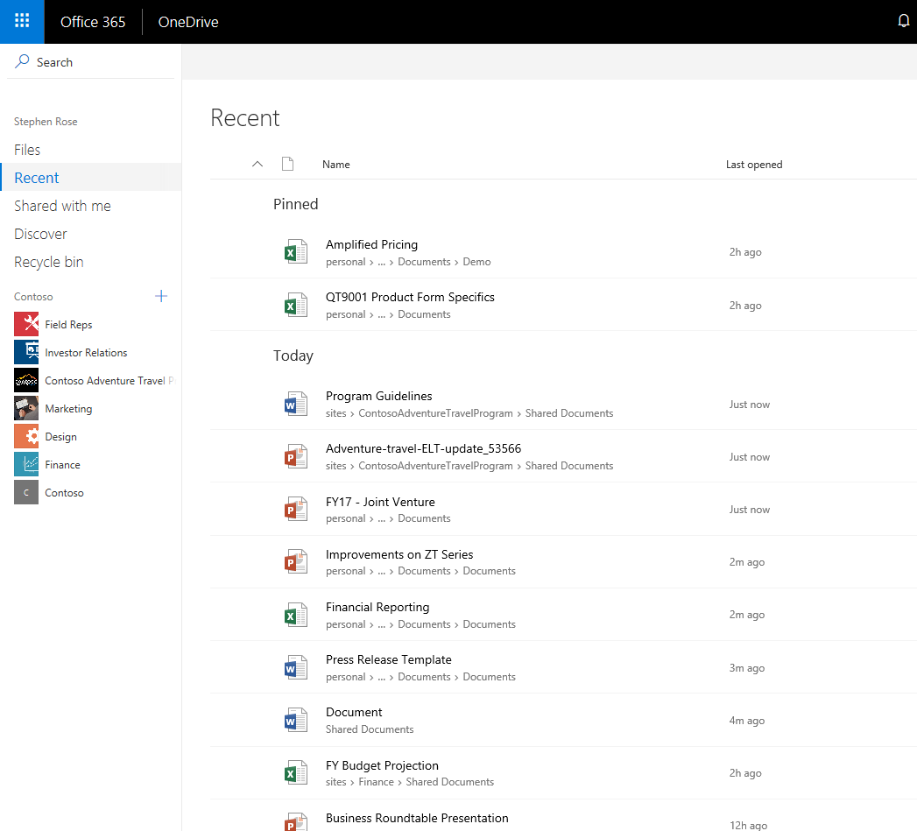
Quickly find files that matter most
Leverage the intelligence of the Microsoft Graph by storing your files in OneDrive
Get back to your recent and pinned files on the web, mobile, or directly in Office
Easily return to files shared with you
Discover files and get personalized search results from people and sites relevant to you

Slide 13
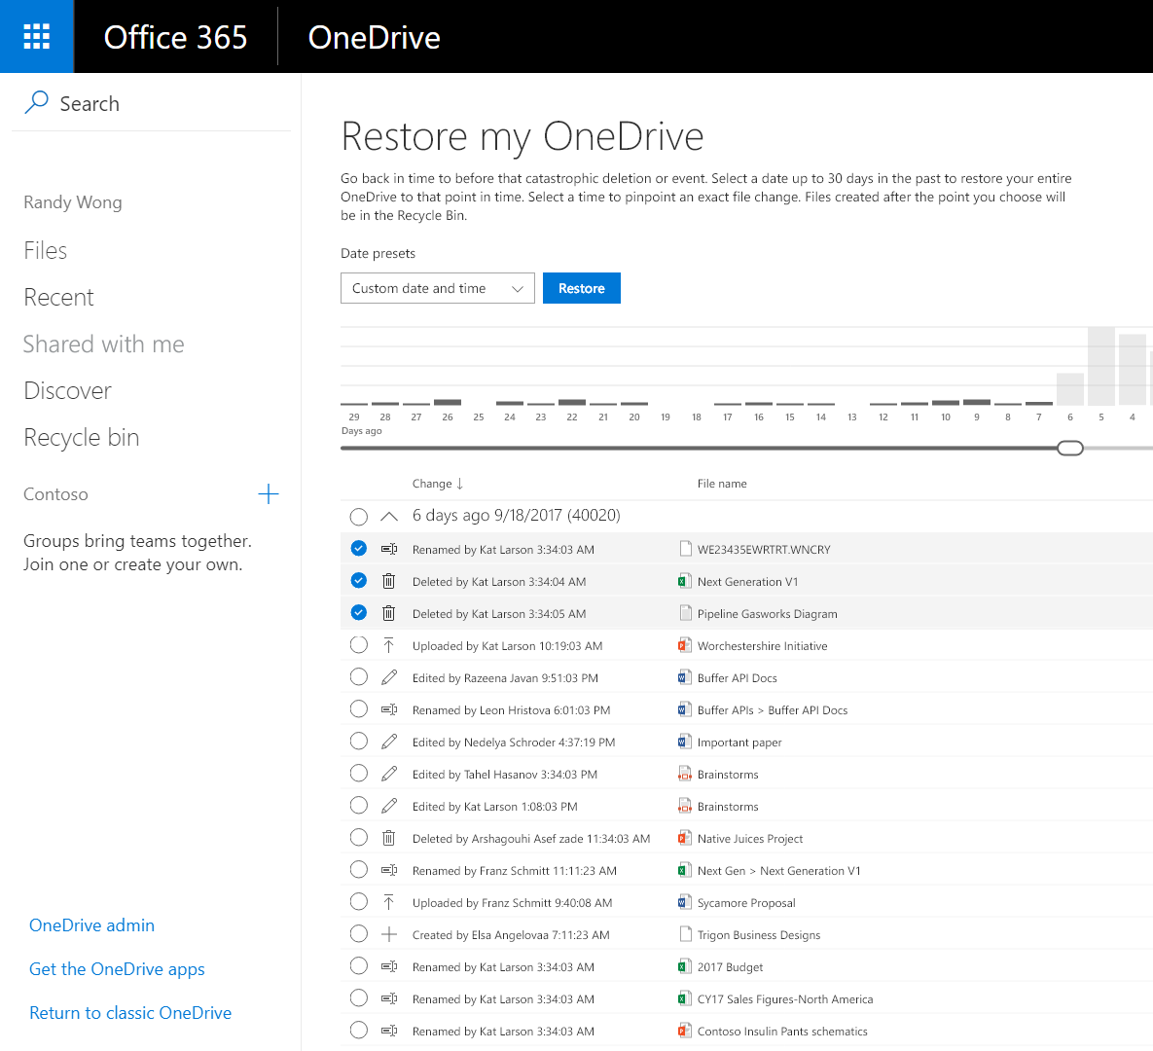
Protect your work
Files are encrypted at rest and in transit
Undo or rollback changes using the recycle bin and version history
Recover from mass file corruption with self-service restore
Be notified of file access

Slide 14
Keeping your data safe
Files
Your files are the heart of your business
Losing content
Can disrupt or destroy productivity
INTRODUCING FILES RESTORE
Allowing self service recovery for the last 30 days up to the second
Recover from accidental deletes, corruption, or ransomware events

Slide 15
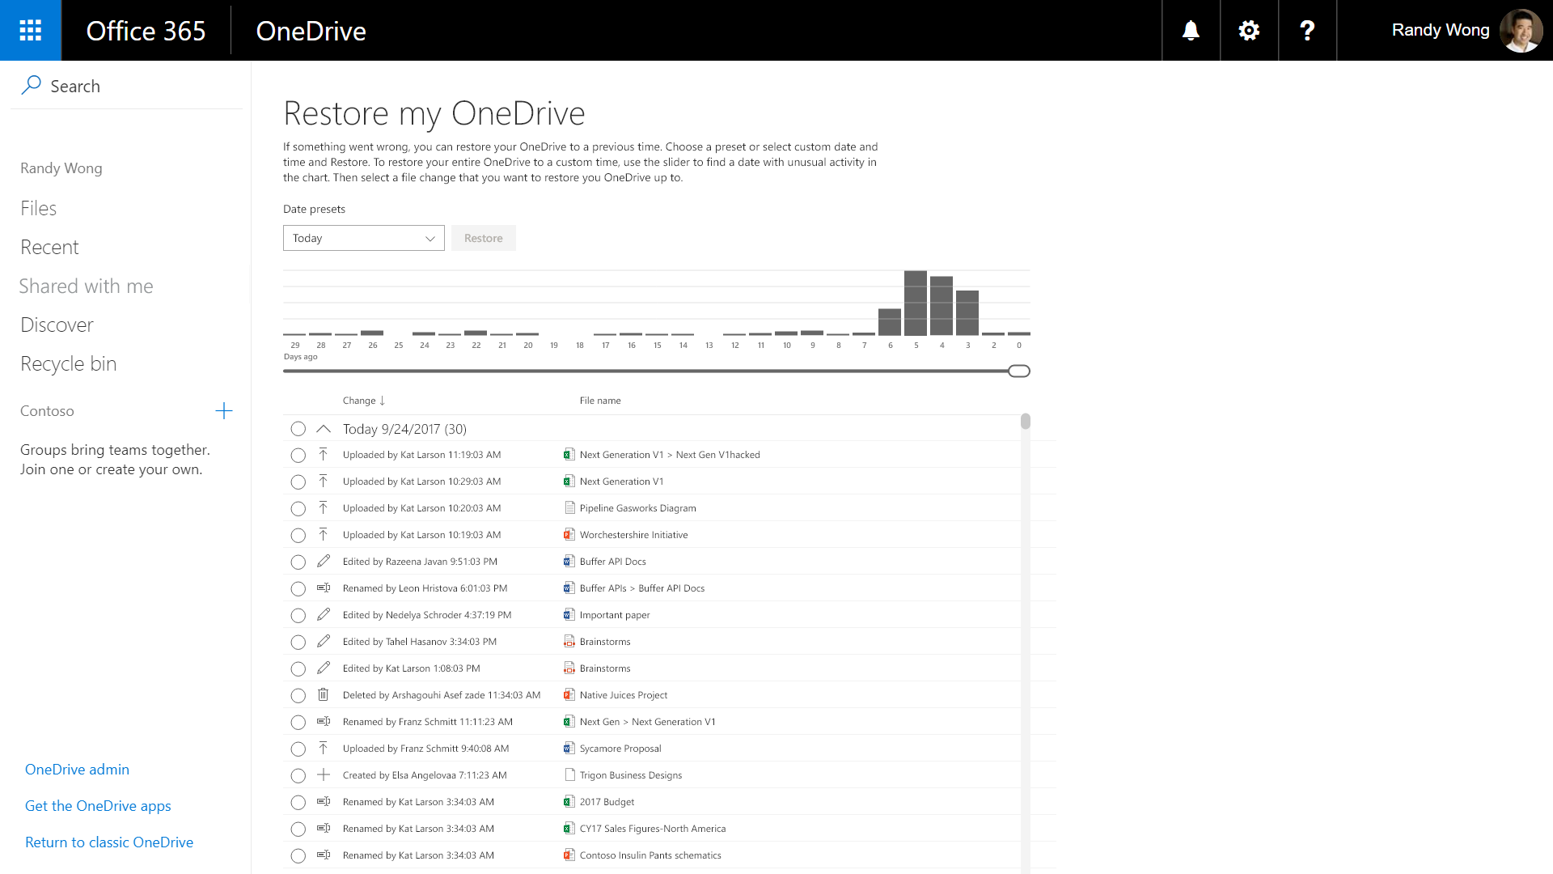

Slide 16


Slide 17

Are you sure you want to restore your OneDrive?
Restoring your OneDrive to 8/12/2017 3:49:02 PM will revert 2300 changes.
Restore
Cancel

Slide 18
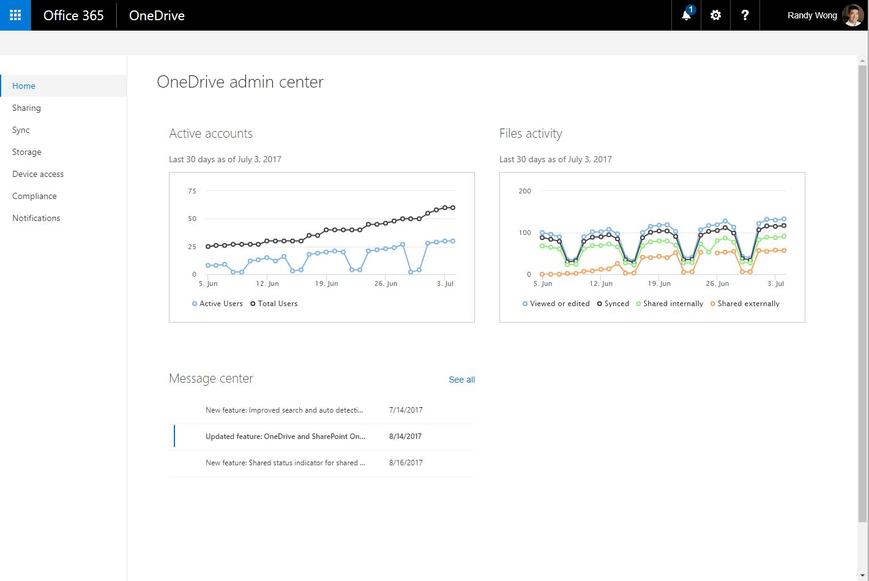
Protect and manage for admins
Rest easy with global scale, reliability, and compliance
Protect your files with sharing and security controls in the OneDrive admin center
Apply conditional access policies
Bring Office 365 to your datacenter with hybrid capabilities
Comply with data residency requirements with multi-geo support

Slide 19
Roadmap—OneDrive
 | FUNDAMENTALS | SYNC AND MOBILE | COLLABORATION AND SHARING | SECURITY AND ADMIN
LATE CY2017 | File hover card Microsoft Flow integration Zip file support Photo intelligence | Files On-Demand New file previewers Support for on-premises with Android app | Secure external sharing | Multi-geo (private preview) Service level encryption (private preview)
EARLY CY2018 | Move from OneDrive to SharePoint Mac Office co-authoring | IRM library sync Mac Office sync integration (preview) Improved end user onboarding on mobile Additional file preview support on mobile | External sharing reports Comments on non-Office files Shared by me Updated mobile sharing Shared with me on mobile (updated UI) | Files restore Sync conditional access Files On-Demand admin controls Full ITAR and multi-geo support on mobile

Slide 21
Moderne Dateianhänge

Slide 22
Demo

Slide 23
OneDrive Next Steps
Go to onedrive.com/business to learn more
Engage with us and the community at techcommunity.Microsoft.com/onedrive
Get onboarding and adoption assistance at fasttrack.microsoft.com
Leverage the OneDrive help center at
support.office.com/onedrive
Provide product feedback at onedrive.uservoice.com

Slide 24

Thomas Stensitzki
Granikos GmbH & Co. KG
MCT MCSM Messaging, MCM: Exchange 2010 MCT, MCSE, MCITP, MCTS, MCSA, MCSA:M, MCP
thomas.stensitzki@granikos.eu http://JustCantGetEnough.granikos.eu

Slide 25

OneDrive Umfrage
Thomas Stensitzki
Granikos GmbH & Co. KG
MCT MCSM Messaging, MCM: Exchange 2010 MCT, MCSE, MCITP, MCTS, MCSA, MCSA:M, MCP
thomas.stensitzki@granikos.eu http://JustCantGetEnough.granikos.eu
http://bit.ly/ODB-EXUSG
Notes:
QR Slideshare

